Slide 1
Lecture 03 - Morphology
Prof. André Gustavo Hochuli
gustavo.hochuli@pucpr.br
aghochuli@ppgia.pucpr.br
Notes:
Prof. André Hochuli

Slide 2
Topics
Discussion of Practice 02
Mathematical Morphology
Structuring Element (or Kernel)
Erode /Dilate
Open / Close
Gradients
Watershed
Practice
Computer Vision - Prof. André Hochuli
Lecture 03
Notes:
Prof. André Hochuli

Slide 3
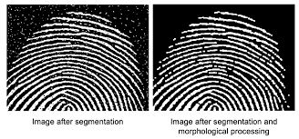
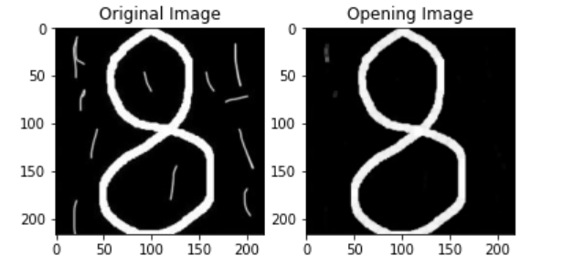


Mathematical Morphology
Morphology (Nature): Branch of Biology that study the form and structure of animals and plants
Morphology (Image Processing): Mathematical operations to extract image components based on pixel neighborhood.
Increase/Decrease Objects Size, Reduce Noise, Closing or Open (GAPS)
Computer Vision - Prof. André Hochuli
Lecture 03
Notes:
Prof. André Hochuli

Slide 4
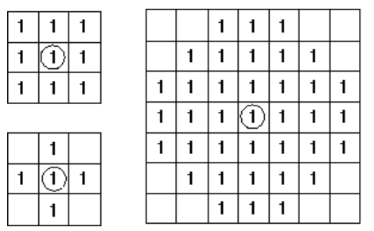
Structure Element (Kernel)
Defines the shape of structure to be applied
The Structure is slided thought the image
Erosion or Dilate operations is applied
The origin determines the pixel to be changed
Computer Vision - Prof. André Hochuli
Lecture 03
Notes:
Prof. André Hochuli

Slide 5
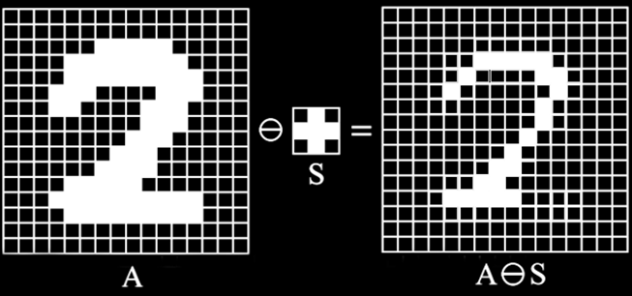
Erosion
Move ones to zero
Binary ‘AND’ Operation
Reduce Noise and Contours
Computer Vision - Prof. André Hochuli
Lecture 03
Notes:
Prof. André Hochuli

Slide 6
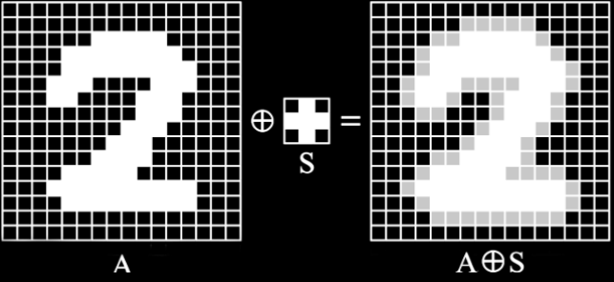
Dilatation
Move zeros to ones
Binary ‘OR’ Operation (HIT)
Increase Objects, Connect Contours and Fill holes
Computer Vision - Prof. André Hochuli
Lecture 03
Notes:
Prof. André Hochuli

Slide 7


Opening and Closing
Opening: Erode + Dilate
Removes small objects and thin lines
Closing: Dilate + Erode
Filling small holes
Both Operations preserving the shape and size of large holes and objects in the image
Computer Vision - Prof. André Hochuli
Lecture 03
Notes:
Prof. André Hochuli

Slide 8

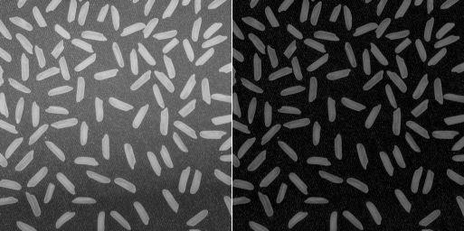
Others Morphological Operations
Gradient: Erosion - Dilate
Outline de Object
TopHat: Open – Original Image
Reduce the effect of brightness changes
Isolates brightness objects
Computer Vision - Prof. André Hochuli
Lecture 03
Notes:
Prof. André Hochuli

Slide 9
Let’s code!
The link goes here
Computer Vision - Prof. André Hochuli
Lecture 03
Notes:
Prof. André Hochuli

